Slide 1
Last “Half” Lecture…Econ 320 Age 21 to 66: Anything learned worth passing on? Don’t Blink
Scott Farrow

Slide 2
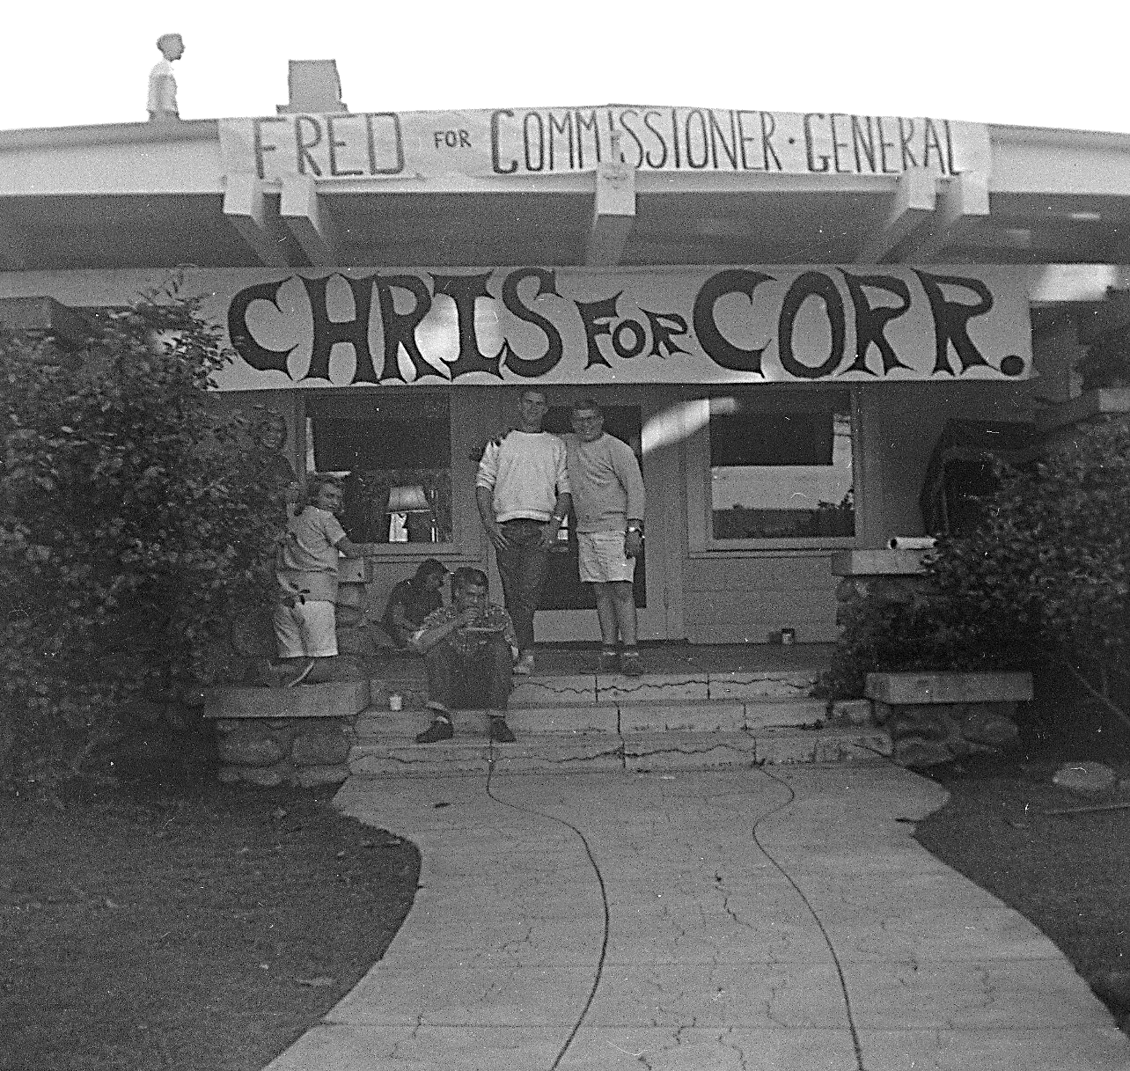
Context: came from
Happily middle class
Public schools through high school
So. Calif.
Brother suicides

Slide 3
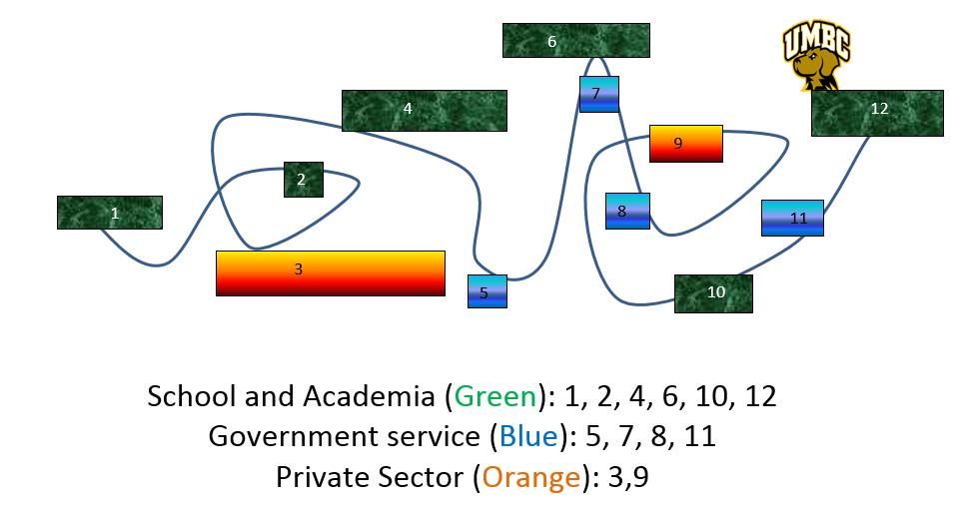
Career Path: Non-linear but moving (not exactly to scale)

Slide 4
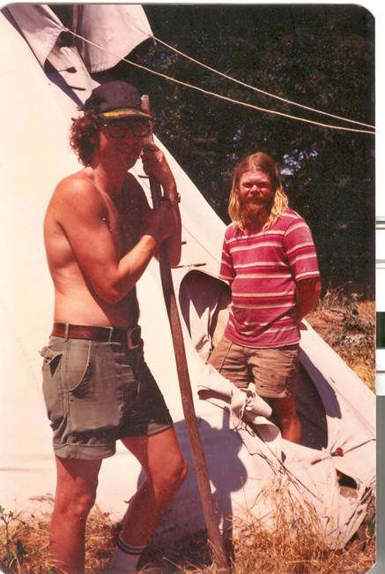
Big Decisions: School choice Ugrad and Grad
Ugrad (2 applications)
Grad
(UC system: UCSC: rejected; UCSB
UC Riverside: dropped out
FARM
Whitman College
Washington State

Slide 5
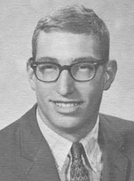
Many Decisions: Jobs
Pre-Ph.D. (~ 20 jobs)
Post Ph.D. (~10 jobs)
University
Laborer: farm, warehouse
Waiter, beer bar-tender
Government
Janitor
Clerk/researcher
Private sector

Slide 6
Ph.D. Issues and Tools
Issues
Tools
Regression
Natural Resources (running out)
Environment:
pollution trading
Water quality/flooding
General Quant Models
Homeland Security
Simulation
Benefit-Cost Analysis

Slide 7
My Big 4 Life Drivers all interacting Big questions are inherently uncertain
A. Character
Freeman’s favorite quote: …Your character becomes your destiny (and character grows from small steps).
B. Relationships
Take time, invest….
Your relationships become your destiny too
Location: see A and B
Job: be responsible, then see A and B

Slide 8
Build your own code to live by Informal Public Service Codes Apologies to MGMT 350-Ethics--(Rumsfeld’s rules, WSJ, 2001)
Don't do or say things you don’t want to see on the front page of the Washington Post (or on utube).
If the staff lacks policy guidance against which to test decisions, their decisions will be random.
Treat each federal (or state) dollar as if it was hard earned. It was -- by a taxpayer.
If you are not criticized, you may not be doing much.

Slide 9
American Economic Assoc: First code of conduct in ~133 years; April 20, 2018
The AEA's founding purpose ...(Econ) requires intellectual and professional integrity. Integrity demands honesty, care, and transparency in conducting and presenting research; disinterested assessment of ideas; acknowledgement of limits of expertise; and disclosure of real and perceived conflicts of interest.
Economists have a professional obligation to conduct civil and respectful discourse in all forums, including those that allow confidential or anonymous participation.
The AEA seeks to create a professional environment with equal opportunity and fair treatment for all economists..
More at https://www.aeaweb.org/about-aea/code-of-conduct

Slide 10
Conclusion: My recommendations
Make something good happen (at work, in your life)
Ask yourself: What do I want to happen?
First, do your job; then work ahead of your job
Work hard, play hard.
Trust but verify (there are both good and bad people out there)
Assume there are mistakes in your work…and find them
Be who you are….. or you become who you pretend to be
Do not be diverted from the truth by what you would like to believe (≈ Bertrand Russell)
Do the extra that excites you
Don’t forget the West --or wherever you came from

Slide 11
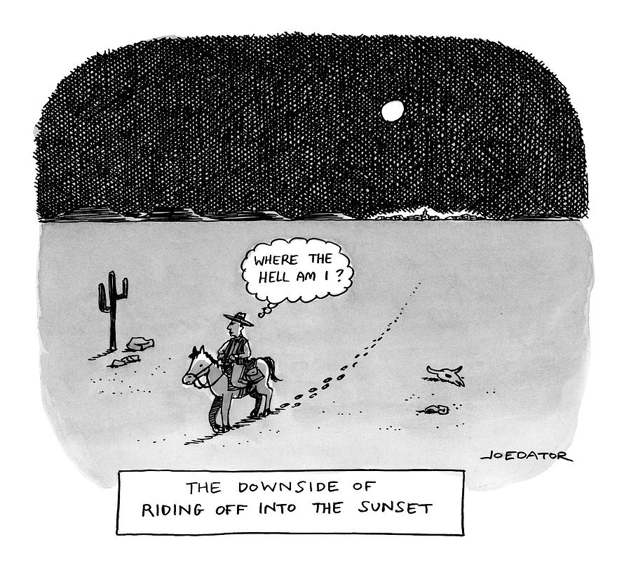
The downside of riding into the sunset

Slide 12
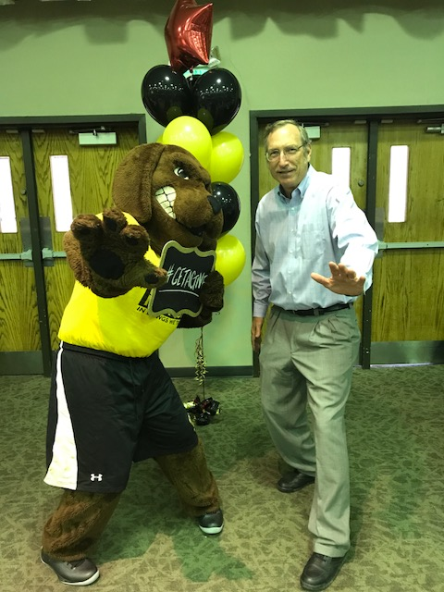
Final: …hour exam
10:30 lab 1
11:30 lab 2
Bring hard copy of paper
and upload electronic
Build a good life

